Slide 1

Problems on Confidence Interval 2013

Slide 2
Reference
Data
Youtube
Code

Slide 3
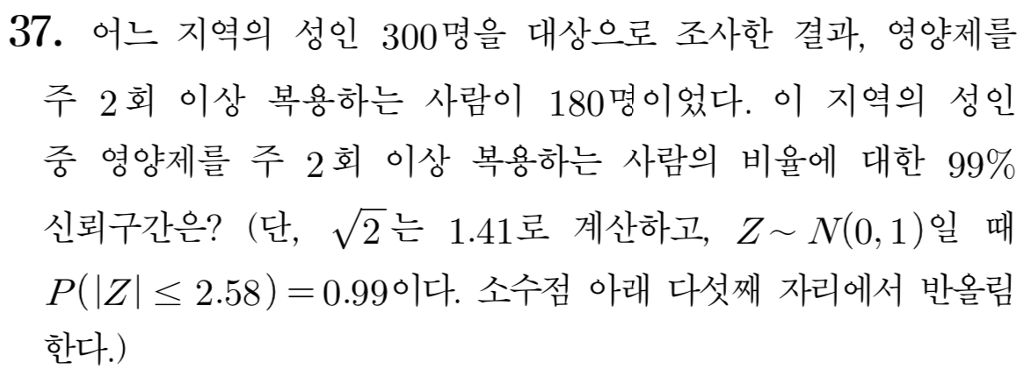
[2013]

Slide 4
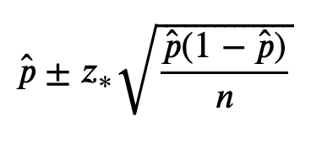

Slide 5
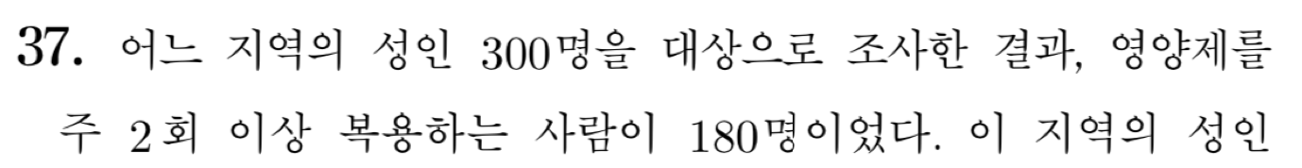

Slide 6
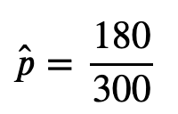

Slide 8


Slide 9


Slide 12


